Slide 1
Connections
Introduction to ADO.NET Connections
Instantiating a new connection
Using a connection object
Connection Pooling
Notes:
Click through to the next slide…

Slide 2

Learning Objectives and Overview
After completing this learning
unit, you should be able to:
In this section, we will discuss the following:
Understand what ADO.NET connection objects are and use them in your .NET application to connect to a data source.
What is an ADO.net connection?
What is a DbConnection Object?
What are the important methods and properties of the DbConnection class?
What is a SqlConnection object?
How to Instantiate a new SqlConnection object?
How to use a connection to retrieve data?
What is connection pooling?
Notes:
Course or Module Title
2
Date or Rev. #
Our objective here is to understand the importance of Polymorphism in Java and the ways we are going to implement it in Java.
After doing the practice exercises included in this section, you should be able to include polymorphism concept wherever it is appropriate to your code.
Excellere Restricted

Slide 3
The ADO.NET Connection - 1
A connection object represents the connection between a .NET application and the data store.
In case of a client server model like SQL Server, it represents the physical connection between the database server and the client.
Each of the .NET Framework data providers provide their own connection classes.
Example- The connection class provided by the SQL Server provider is SqlConnection .
All of these connection classes have been derived from the DbConnection class present in the System.Data namespace.
The DbConnection class provides the basic methods and properties which are required to create and manage connections in a data driven .NET application.

Slide 4
The ADO.NET Connection - 2
The DbConnection class contains the open() method which is used to open a new connection with a database.
The close() method in the DbConnection class can be used to close an open connection.
These methods are inherited by all the child connection classes such as SqlConnection and OleDbConnection.
Moreover, the methods are used to open and close the connections
The DbConnection class also contains methods to manage database transactions.

Slide 5
The Connection Classes in ADO.NET
DbConnection
SqlConnection
OleDbConnection
ODBCConnection
OracleConnection
Notes:
This figure shows the connection classes provided by each of the .NET Framework Data providers.
The connection classes exposed by the four built-in data providers have been derived from the DbConnection class.

Slide 6
Important Properties of the DbConnection Class
DbConnection
ConnectionString
Database
State
DataSource
ServerVersion
Notes:
The figure shown here lists some of the important properties of the DbConnection class.
The ConnectionString property of the class holds information such as the user-name, password, the data source name and the database name to which a connection has to be established.
The DataSource property typically specifies the name of the server to which a connection has to be established.
The ServerVersion property specifies the version of the server to which a connection is being made.
The Database property specifies the name of the database for the connection.
The State property of the connection specifies whether the connection is open or closed.

Slide 7
Important Methods of DBConnection Class
Open( )
ChangeDatabase( )
Close( )
BeginTransaction( )
CreateCommand( )
Notes:
The DbConnection provides the basic methods to open close and manage connections in ADO.NET. The connection classes provided by each of the providers inherit these methods from the DbConnection class.
Some of the methods are:
The Open() method of the connection object is used to open a connection.
The Close() method is used to close an open connection.
The BeginTransaction() method is used to begin a database transaction.
The ChangeDatabase() method is used to change the current database of a connection object.
The CreateCommand() method creates a DbCommand object associated with this connection.
The command object created can be used to execute various database operations.

Slide 8
SqlConnection Object
SqlConnection Object represents the connection between a .NET application and a SQL Server.
Since SQL Server is a client-server based database server, the SqlConnection object represents the physical network connection between the database server and our .NET application.
SqlConnection Object is present in the System.Data.SqlClient package which is the .NET framework data provider for SQL Server.
The SqlConnection class is used to establish a connection between the database and our application.
Once the connection is in place, classes such as SqlCommand, SqlDataAdapter and SqlDataReader are used to read and manipulate the data stored in the database server.
The SqlConnection class has been declared as a sealed class and thus cannot be inherited.

Slide 9
Methods to Create a New Data Connection - 1
There are various methods that can be used to create a new connection in the.NET application.
For example,Server Explorer window of Visual Studio is used to create a new connection quickly and easily, as Visual Studio provides us with a wizard that guides us through the steps to create a new connection.
Once a connection is created in the Server Explorer window it can be used where ever required.
We can also create a connection through our code.
To create a connection using code, we first create an object of the appropriate connection class depending on the type of data source being used.
Then we specify the credentials required to establish the initial connection by setting the connection’s ConnectionString property. Once the connection object is created, we use its open() method to open the newly created connection.

Slide 10
Methods to Create a New Data Connection - 2
We can also create a connection using the Data Adapter Configuration Wizard and the Data Form Wizard.
The Data Adapter Configuration Wizard helps us in setting the properties of a new or existing Data Adapter.
The Data Adapter object contains the methods and statements used to load data from a data source into the dataset.
The Data Form Wizard guides us through the steps to create a web form or a windows form that contains controls to display data from a data source.
These controls are also known as data bound controls. These controls are bound to the underlying data such that any change in the data source is reflected in the controls.
Similarly any changes made to the data through these controls are reflected in the underlying data source.

Slide 11
Creating a Connection Programmatically
Import the required namespaces
Create an object of the appropriate connection class
Pass the credentials to access the data store as the connection string.
Open the connection
Notes:
This figure lists the steps that need to be carried out in order to create a connection programmatically.
The first step is to import the required namespaces.
For example, If we are creating a connection to connect to a SQL server then we need to import the System.Data.SqlClient namespace to be able use the SqlConnection class.
The second step is to create an object of the appropriate connection class depending on the data provider we want to use.
The third step is to construct a connection string which will hold details such as the database, the username, the password and the other details which are required to establish the connection.
The fourth step is to open the connection using the open() method once the object of the connection class has been created.

Slide 12
Creating a Connection Programmatically - Example
using System;
using System.Data.SqlClient;
namespace ConnectionExample1
{
class ConnectionExample
{
static void Main(string[] args)
{
//Prepare a connection string with login credentials
String conString = "server=localhost;user=sa;pwd=password;initial catalog=northwind";
//create a new object of the SqlConnection class using the connecton string created
SqlConnection con = new SqlConnection(conString);
try
{
//open the connection
con.Open();
Console.WriteLine("Connection established successfully");
Console.WriteLine("Conneted to {0} with the database {1}....", con.DataSource, con.Database);
con.Close();
Console.WriteLine("Connection closed successfully");
}
catch (Exception e)
{
Console.Write(e.ToString()); Console.ReadLine();
}
}
}
System.Data.SqlClient namespace is imported because we are connecting to a SQL Server running on the local computer.
In the main method String variable called conString is declared which will be used as the connection string for the connection.
We then instantiate an object of the SqlConnection class and pass the connection string variable conString as a parameter to its constructor.
The connection is opened by using the open method.
If the connection is opened successfully without an exception, a message stating that the connection was opened successfully is displayed.
DataSource and the Database properties of the SqlConnection object are used to display the name of the server and the database that the connection is associated with.
If the connection fails, an error message is displayed to inform the user about the exception thrown.

Slide 13
The Connection String - 1
The ConnectionString property of the connection object contains the details which are required to establish a connection with the data source.
A connection string contains multiple parameters.
The parameters in a connection string are separated using a semi colon (;).
The Data Source or Server parameter of a connection string specifies the name of the server to which the connection has to be established.
The Initial Catalog or database parameter specifies the name of the database to be connected to.
The Integrated Security parameter can take either ‘true’ or ‘false’ as values. When the value is ‘false’ the user id and the password to be used for the connection are specified in the connection string.
If it is specified as ‘true’ then the current windows account credentials are used to log in to the database server also.

Slide 14
The Connection String - 2
The User id parameter is used to specify the username to be used for the connection. This parameter should not be used if the value for the Integrated Security parameter is ‘true’.
The Password parameter is used to specify the password to be used for the connection. This parameter can also be omitted in case Integrated Security is being used.
The Pooling parameter takes a value as ‘Yes’ or ‘No’ to specify whether connection pooling should be used for this connection.
String conString = “server=localhost;user=sa;pwd=password;initial catalog=northwind";

Slide 15
Connection String in the app.config File - 1
All the connection strings required by an application can be globally stored in the app.config file.
This makes sensitive information like user names and passwords which are a part of connection strings less prone to security vulnerabilities and maintenance issues.
Moreover every time a change is made in the connection string we do not need to make changes to the code in our application.
This helps us by allowing us to change the connection strings without recompiling the application.
The app.config file can contain all the connection strings required by an application.
The connection strings can be stored in multiple name and value pairs in the connection strings section of the Configuration element.

Slide 16
Connection String in the app.config File - 2
For each connection string that is stored in the app.config file, we need to specify the name of the connection string, the data provider for the connection string and the actual connection string.
The connection strings can be retrieved in the application by using the name given to them in the app.config file.

Slide 17
Adding a Connection String in app.config File
The file is in XML format and contains the <configuration> element.
Adds the <connection string> in the app.config file.
The <connectionStrings> element is a sub element of the <configuration> element.
The <connectionString> element defines a connection string in the configuration file.
<?xml version='1.0' encoding='utf-8'?>
<configuration>
<connectionStrings>
<add name=“NwndString" providerNe="System.Data.SqlClient" connectionString=" server=localhost;user=sa;pwd=password;initial catalog=northwind " />
</connectionStrings>
</configuration>
The <connectionStrings> contains a sub element <add> which can be used to add connection strings to the file.
The <add> element takes the name and provider of the connection string along with the connection string as attributes.

Slide 18
Retrieving a Connection String From app.config
We can retrieve a connection string stored in the app.config file using the classes of the System.Configuration namespace.
The ConnectionStrings property of the ConfigurationManager returns a ConnectionStringSettings Collection
Collection of ConnectionStringsSetting Object represents a single entry in the connectionStrings section.
We can use the Name, ProviderName and the ConnectionString properties of the ConnectionStringSettings class to retrieve information about a connection string
Using System.Configuration;
static string GetConnectionString (string name)
{
string returnValue = null;
ConnectionStringSettings settings = ConfigurationManager.ConnectionStrings[NwndString];
if (settings != null)s
returnValue = settings.ConnectionString;
return returnValue;
}

Slide 19
Connection Pooling - 1
Connection pooling is a technique used by .NET to reduce the cost of opening new database connections by minimizing the number of times a new connection must be opened.
It is automatically handled while using data providers for OleDb, ODBC and Oracle. In case of SQL Server the application programmer is given the option to handle the connection pool themselves.
The connection pooler maintains a pool of connections by keeping a predefined number of connections with the same configuration string alive in the pool.
The pooler takes ownership of the physical connections.
Connections with identical configuration information or connection strings are placed in the same pool.
ADO.NET can maintain multiple connection pools, one for each different connection configuration.

Slide 20
Connection Pooling - 2
Whenever a user requests for a new connection to be opened, the pooler looks for an available connection in the pool. If a connection is available in the pool, it is allotted to the user.
If a connection is not available and the number of connections in the pool has not reached it maximum, the pooler opens a new connection and returns it to the user.
Else a new connection is not opened and the pooler throws an exception to notify the user of the failure.
When a user calls the close() method to close a connection, the pooler returns the connection to the pool as a live connection instead of closing it.
Once a connection is finished servicing a client and is placed back into the pool it is ready to be reused again to service another client.

Slide 21
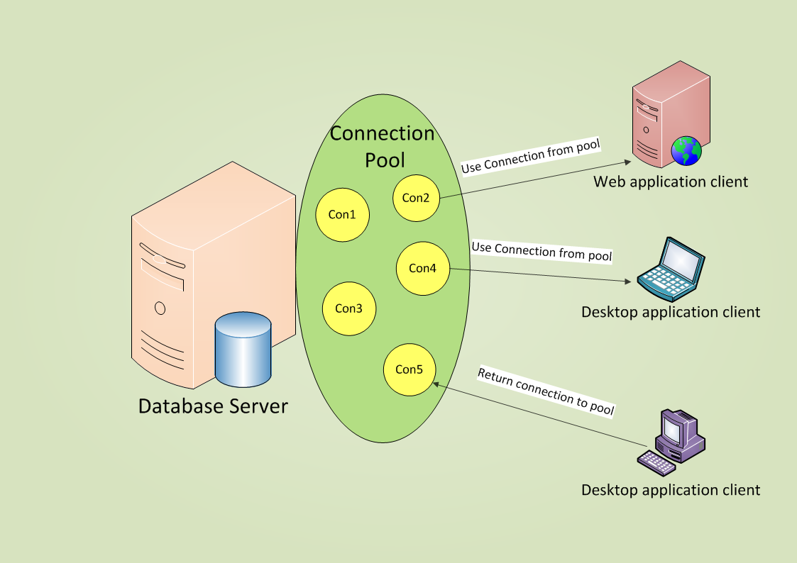
Connection Pooling
Notes:
This figure illustrates how a set of active connections are maintained in the connection pool and how clients can use a connection from the pool when required and return a connection to the pool once they have finished using the connection.

Slide 22
Smart Programming Considerations
For best performance we should always use the data provider that is most appropriate for connecting to the data source that we want to access.
It is always a good practice to delay opening a connection as much as possible and to close a connection as early as possible.
Keeping a connection open for a very long period of time results in unwanted performance overhead.
Whenever it is known that a large number of clients would be using data base connections, it is recommended to use connection pooling to boost the performance of the application.
It is always a good practice to close all the open connections explicitly using the close() method before the application terminates.

Slide 23
Reference Reading
http://msdn.microsoft.com/en-us/library/ms971481.aspx
Note: The links provided here are valid at the time of production of this content. However, web URLs may change from time to time , so users are encouraged to exercise their own judgment in using the information given in the pages referred to by these links

Slide 24
Summary
The connection object in ADO.NET represents a connection between the application and the data source.
Connection Pooling is the technique which helps in reducing the cost of opening new connections.
Connection pooling is a technique used by .NET to reduce the cost of opening new database connections by minimizing the number of times a new connection must be opened.
The parameters in a connection string are separated using a semi colon (;).
We can also create a connection using the Data Adapter Configuration Wizard and the Data Form Wizard.

